Slide 1

Draw your own Architecture

Slide 2
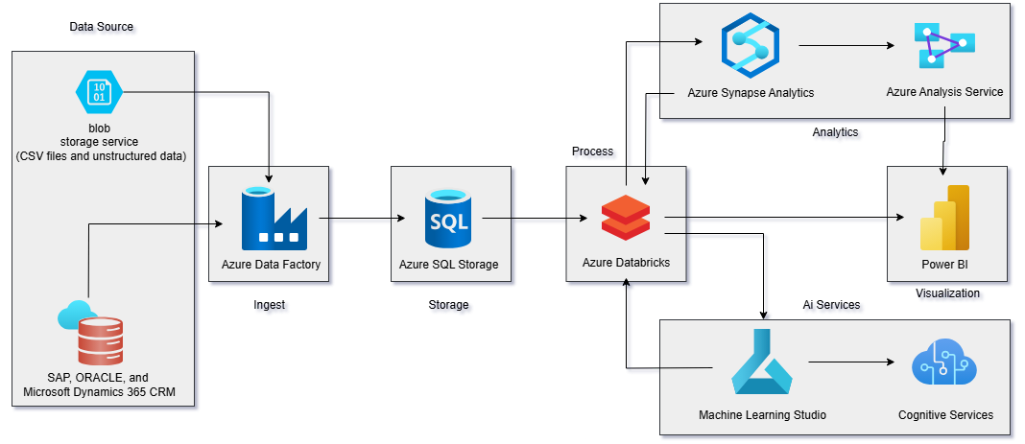
Architecture

Slide 3


Data Source
Blob storage services
SAP, ORACLE, and Microsoft Dynamics 365 CRM
Azure Blob Storage provides scalable, cost-efficient object storage in the cloud. Store and access unstructured data for your most demanding workloads. We were given that company has some unstructured data in blob storage and SAP, ORACLE, and Microsoft Dynamics 365 CRM as their main storage.

Slide 4


Data ingestion
Data Storage
Azure Data Factory
Azure SQL Storage
Azure Data Factory (ADF) is a fully managed, serverless cloud-based data integration service that allows you to create data-driven workflows for orchestrating and automating data movement and transformation at scale. It will help use to ingest the data from different sources and is perfect as per companies needs.
We will be using Azure’s SQL server as the storage space it is perfect to store different kind of data from different sources.

Slide 5

Data Process
Azure Databricks
We will be using databricks to process and train the data for further analysis and visualize, as well as we can process the data for companies future AI projects as well.

Slide 6

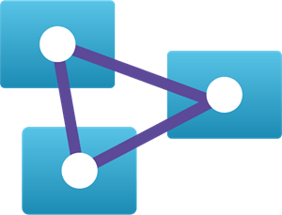
Data Analytics
Azure synapse analytics
Azure analysis services
We are using Azure synapse analytics and Azure analysis services to analyze and derive insights from the data that we processes, as well we can also use this services to model the data.

Slide 7


AI Services
Machine Learning
Studio
Cognitive Services
We will be using Machine learning studio and Cognitive services for companies future AI projects, there are many different models, libraries and tools in this services that company can use for their project.

Slide 8

Data Visualization
Power BI
We will be using Power BI for visualizing the processed and analyzed data, as well as we can use this to produce graphs and visuals for the AI projects that company will make in the future.

Slide 9

Thank you

